Slide 1
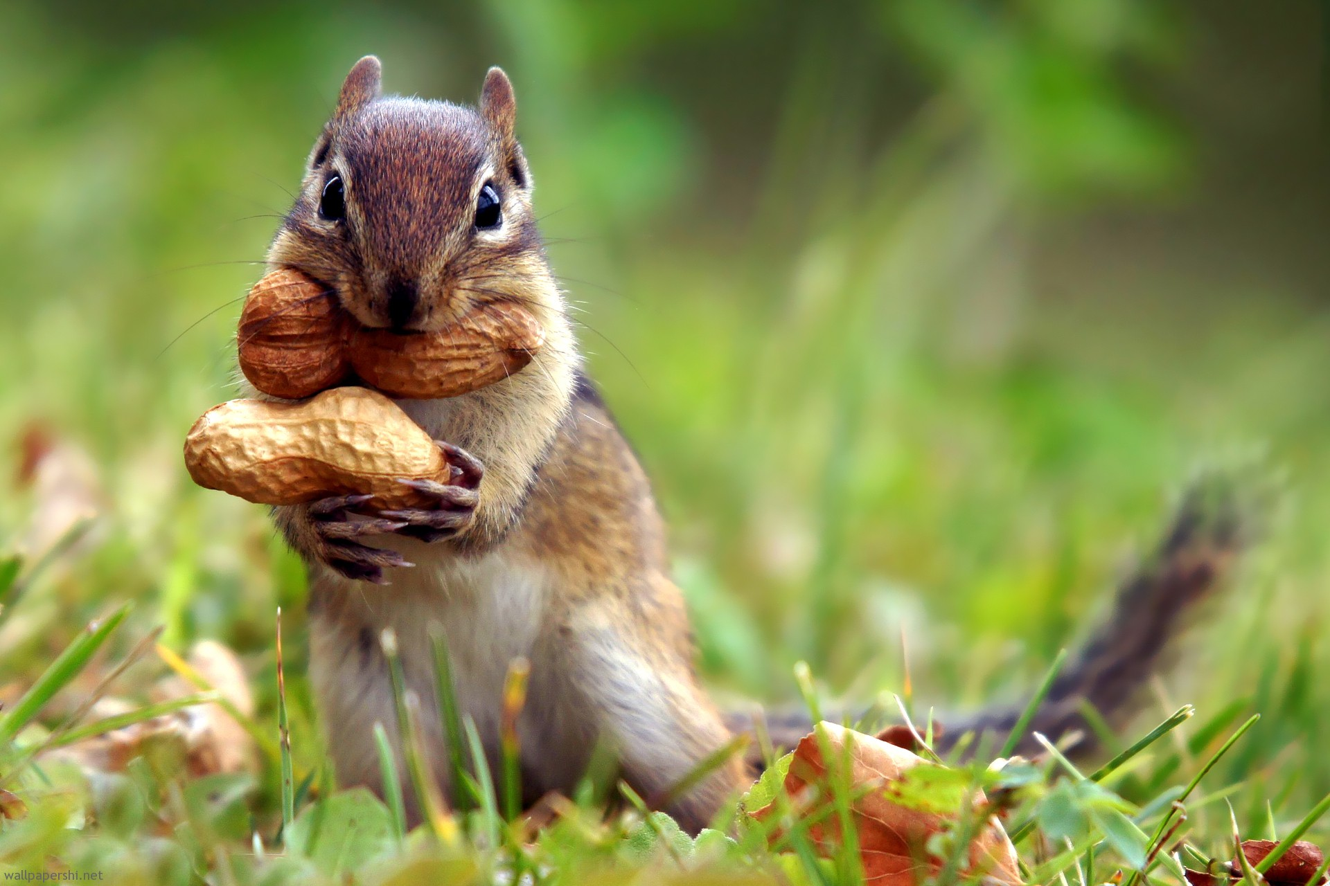
Tim & Moby Present
Tippy the Squirrel

Slide 2
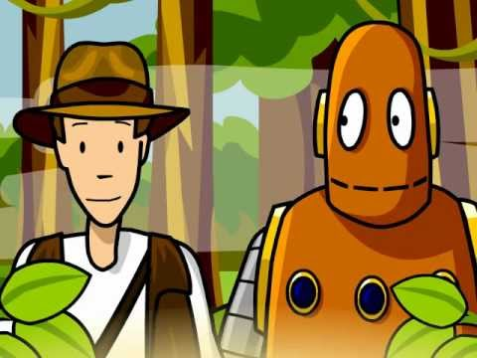
Look at the letter we received from Paul. He wants to know about grey squirrels.

Slide 3
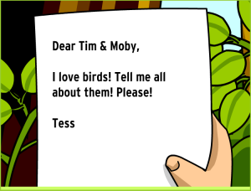
Dear Tim &Moby,
I like to feed the squirrels that visit my back yard, but my dad doesn’t want me to and said they are a nuisance. I would like to learn more about my little fury friends that live in my backyard.

Slide 4

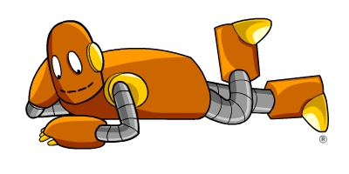
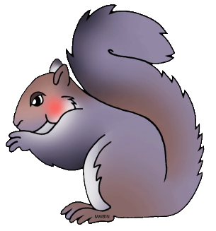
Let’s have our little friend tell you all about himself. Take it away, Tippy!

Slide 5
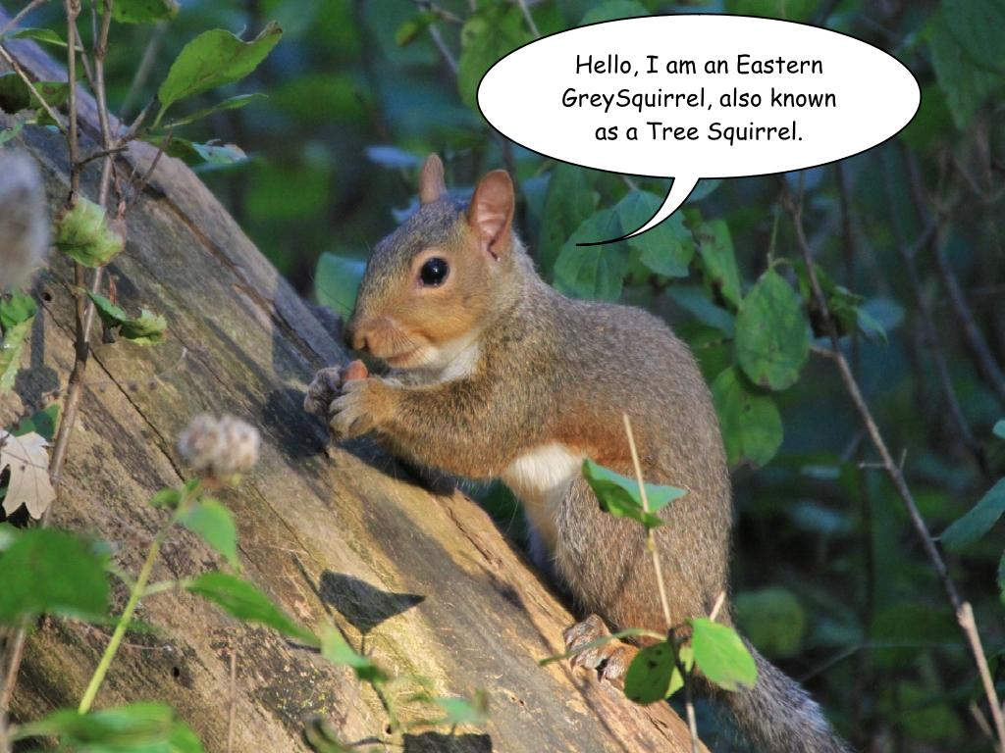

Slide 6
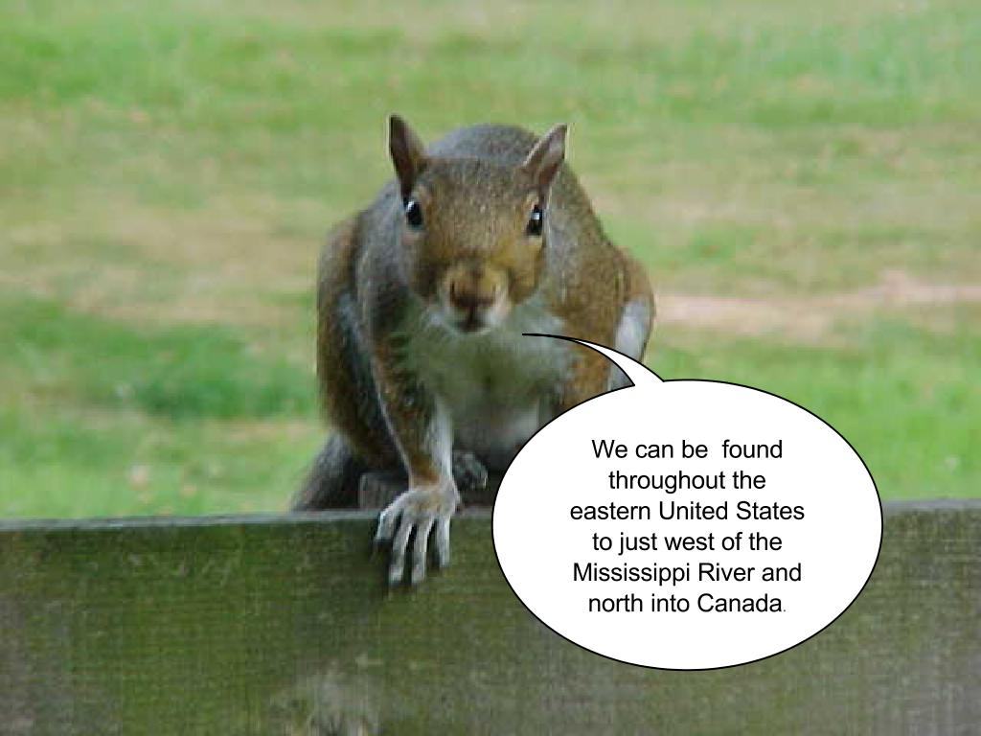

Slide 7
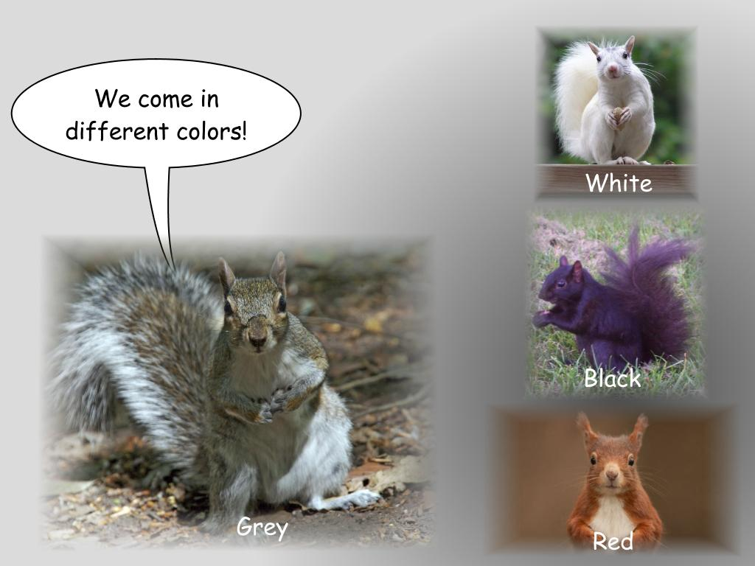

Slide 8
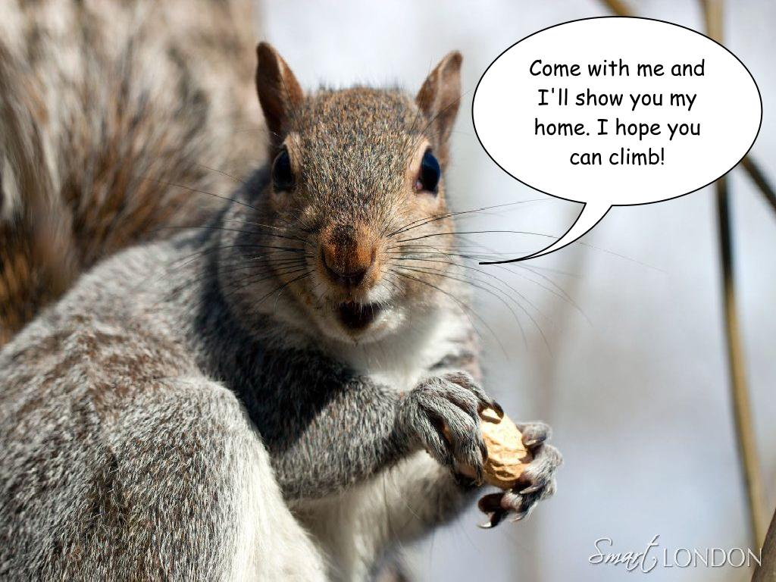

Slide 9
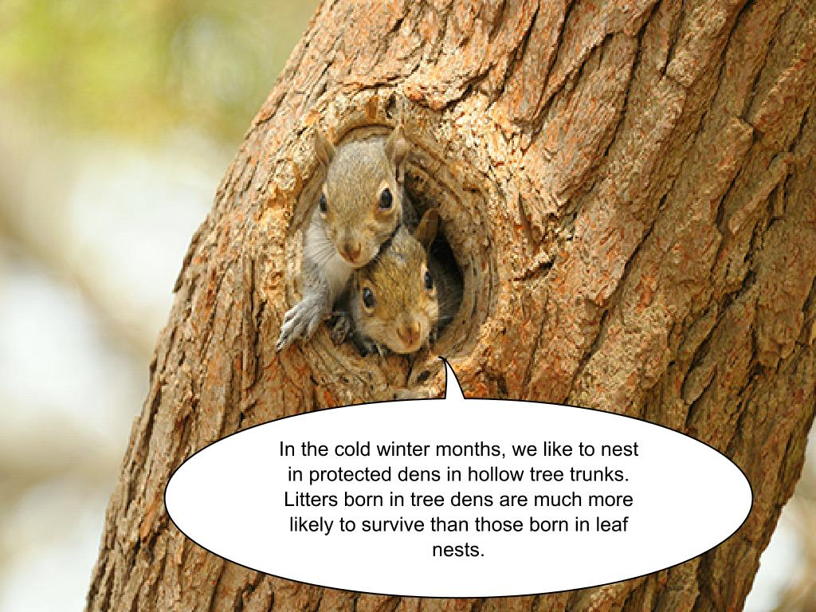

Slide 10
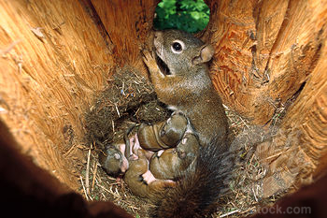
These are my kittens. Yes, I said kittens. That’s what baby squirrels are called.

Slide 11
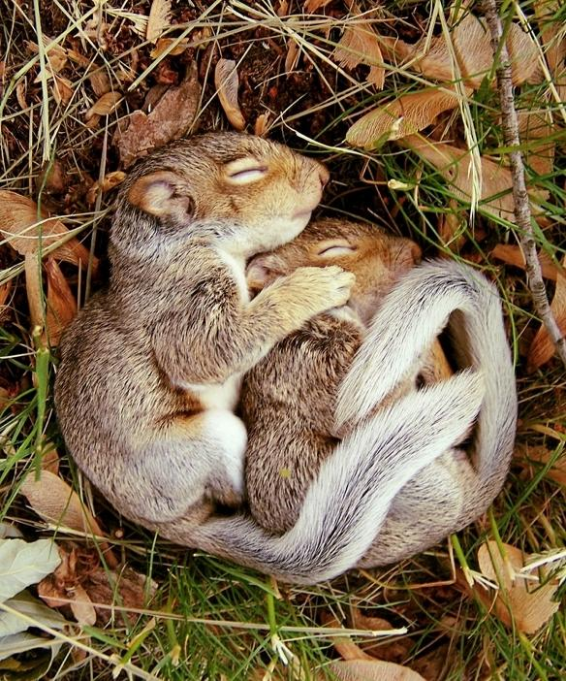
Kittens are born only twice a year. Once in the spring time and once at the end of the summer.

Slide 12
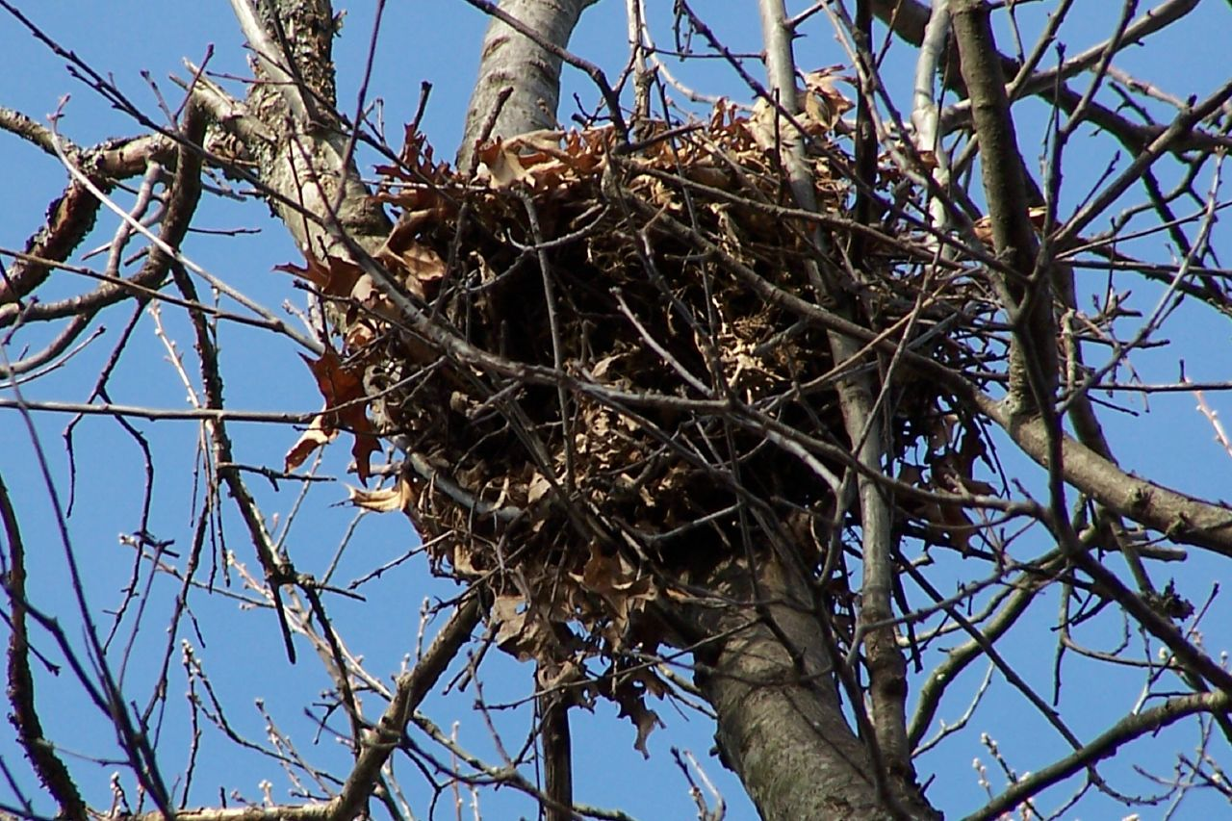
This is our tree nest. We use these in during the warmer months.

Slide 13
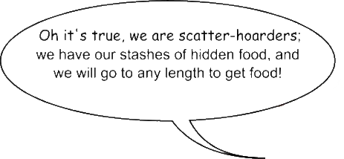
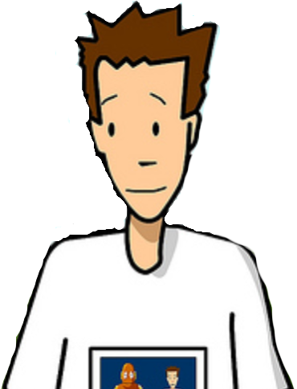
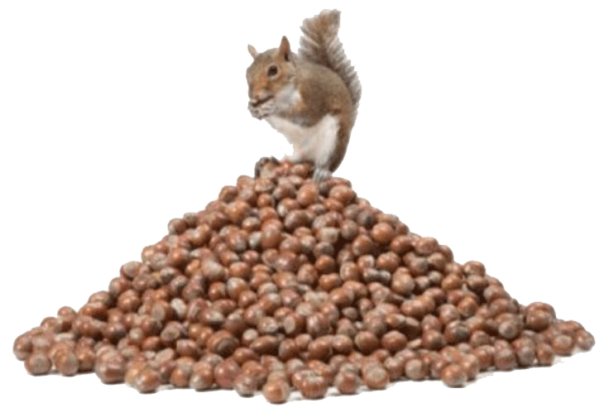

Slide 14
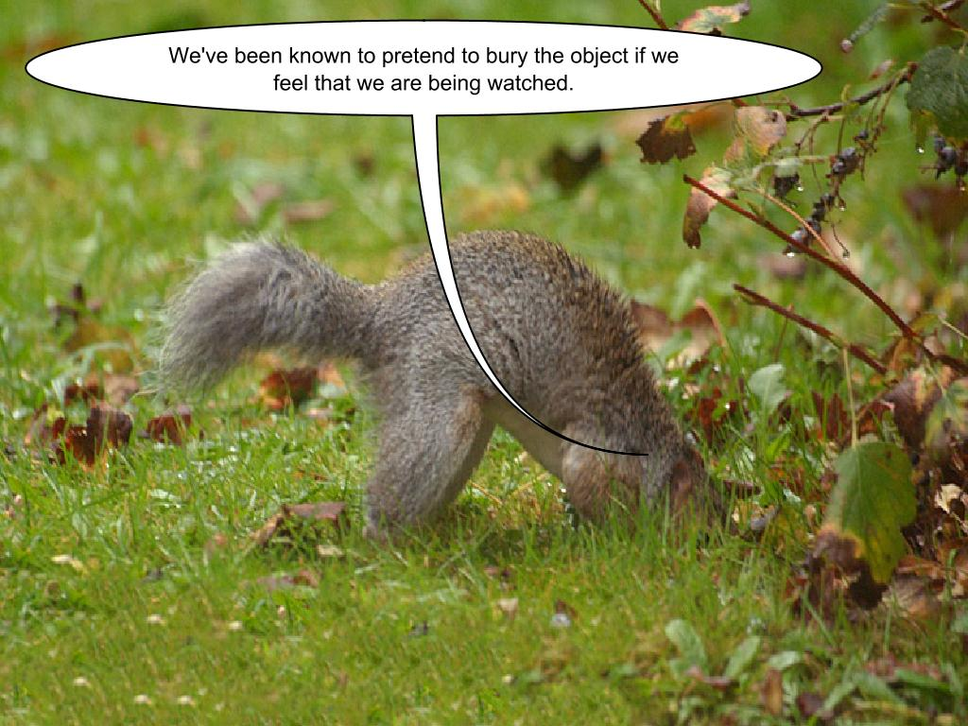

Slide 15
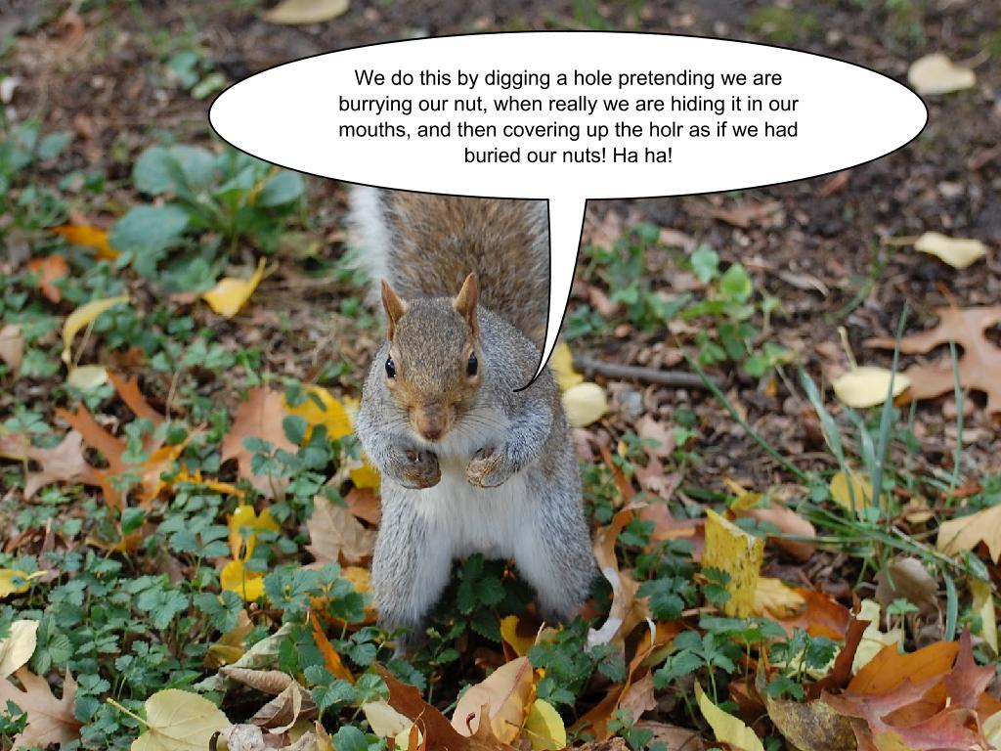
e

Slide 16
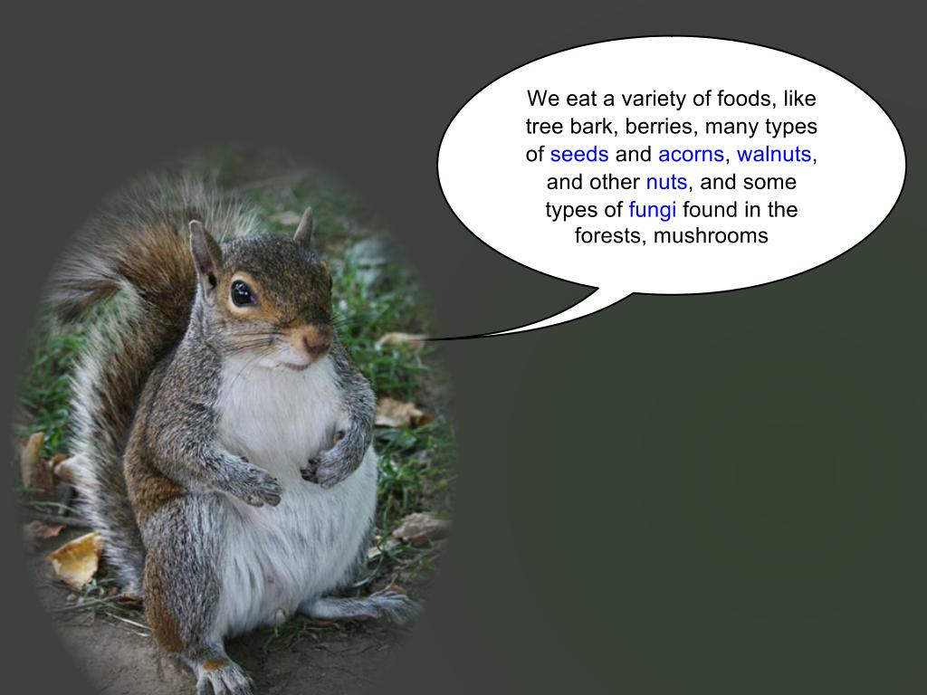

Slide 17
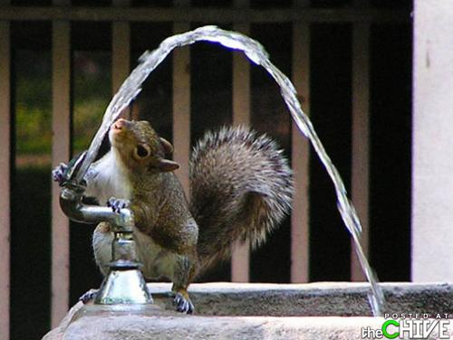
So thirsty!
We need water too!

Slide 18
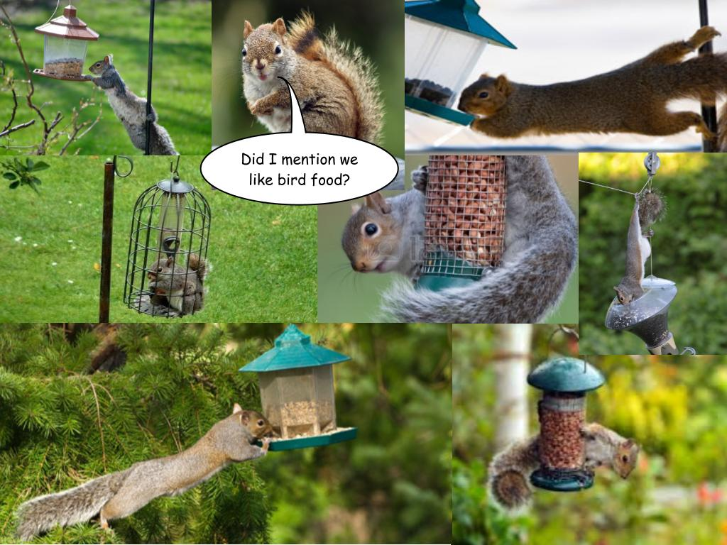

Slide 19
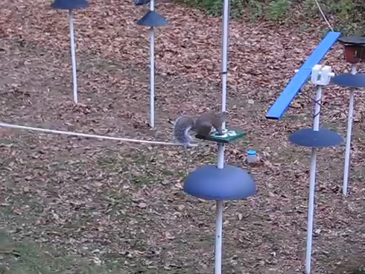


Slide 20
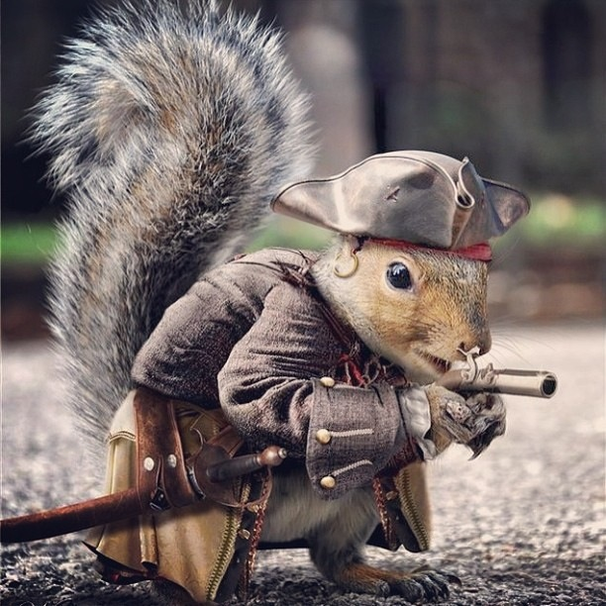

We’ve been around a long time!

Slide 21
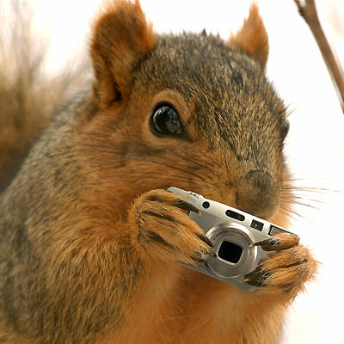
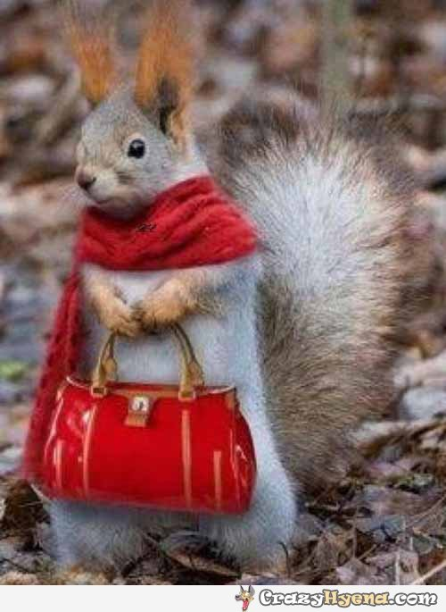
Say Cheese
Cheese
Look how photogenic we are!

Slide 22
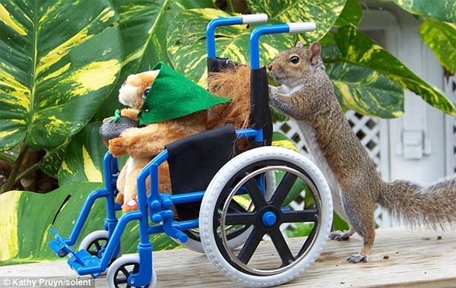
How insulting!
Dang, you are heavy!
The average life span of grey squirrels is very short. If they are lucky, they can live over a year, but the average is between 11 and 12 months.

Slide 23
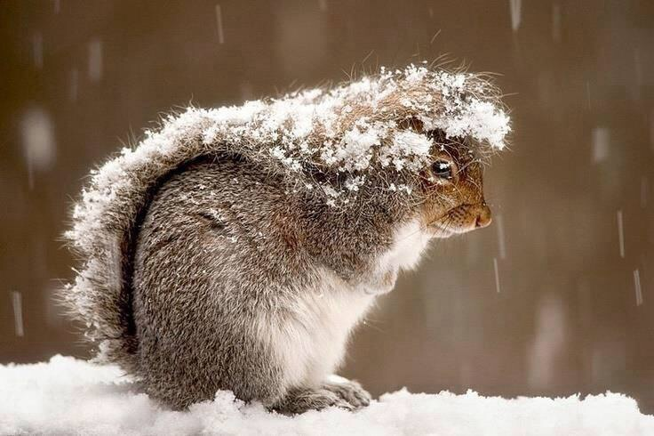
BRRRR….this cannot be good for my health!

Slide 24
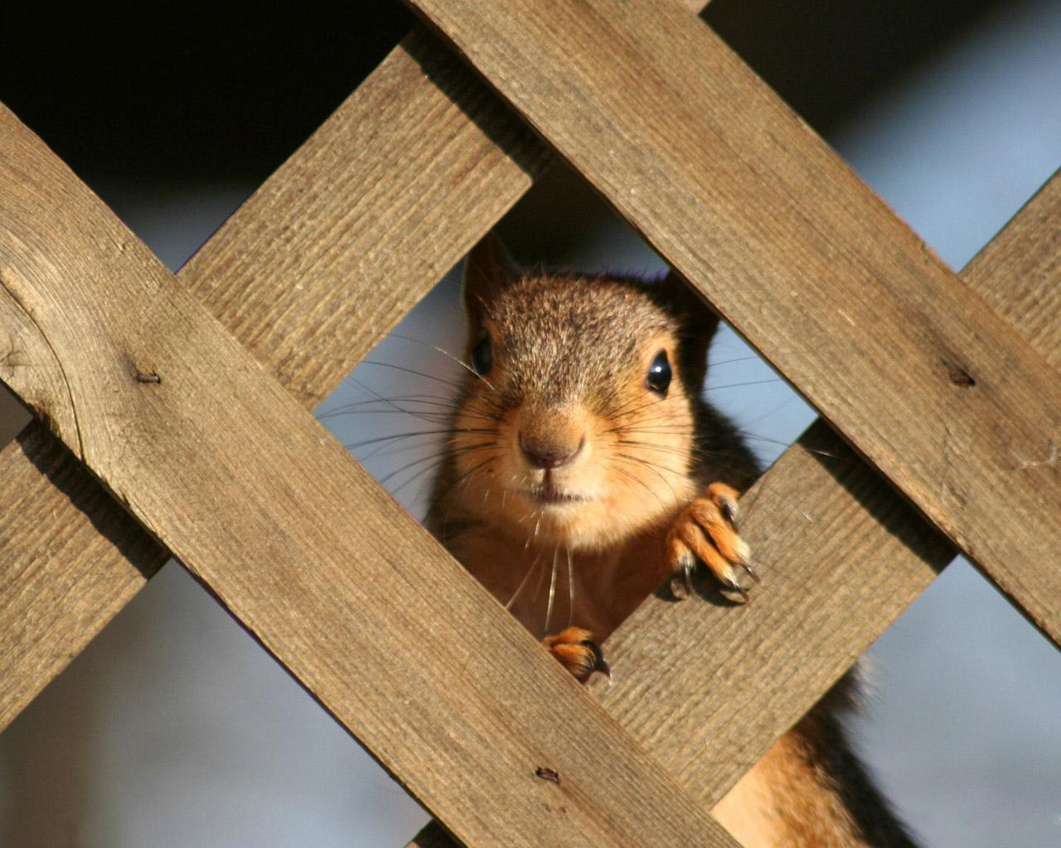
When it’s cold out, and you are snug and warm in your house, how about tossing us some food? Or……

Slide 25
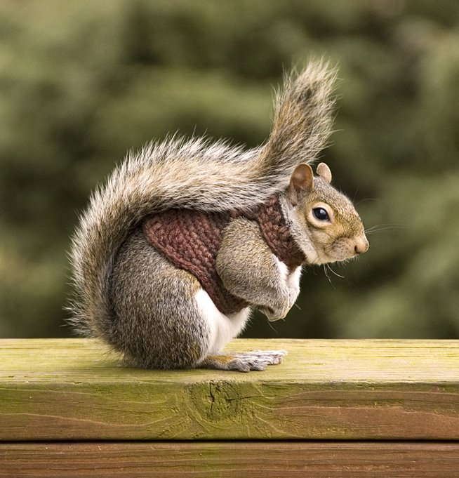
Knitting us a sweater!

