Slide 1
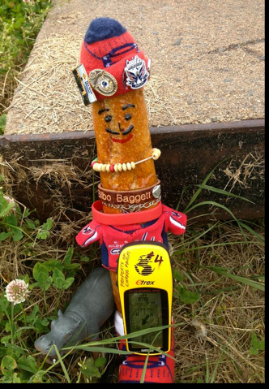
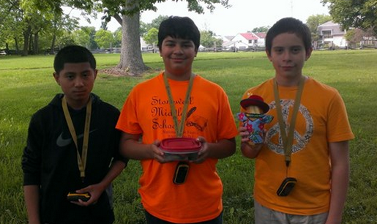
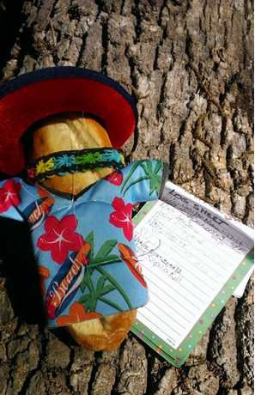
Caching in on Technology
GPS and Geocaching
Good Bread Hunting

Slide 2
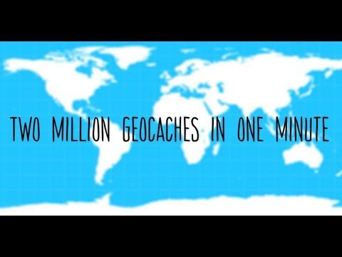
Geocaching – Gone Viral!
There are more than 2,531,795 active geocaches
…. and over 6 million geocachers worldwide.

Slide 3


What is Geocaching?
IN A NUTSHELL…
Notes:
Taking part in a cache hunt is a fun way to learn about the handheld gps. The idea is to have individuals and organizations set up caches all over the world and share the locations of these caches on the internet. GPS users can then use the location coordinates to find the caches. Once found, a cache may provide the visitor with a wide variety of rewards. For classroom learning purposes, the caches are hidden on your school property and are normally not registered on any website for others to find.

Slide 4
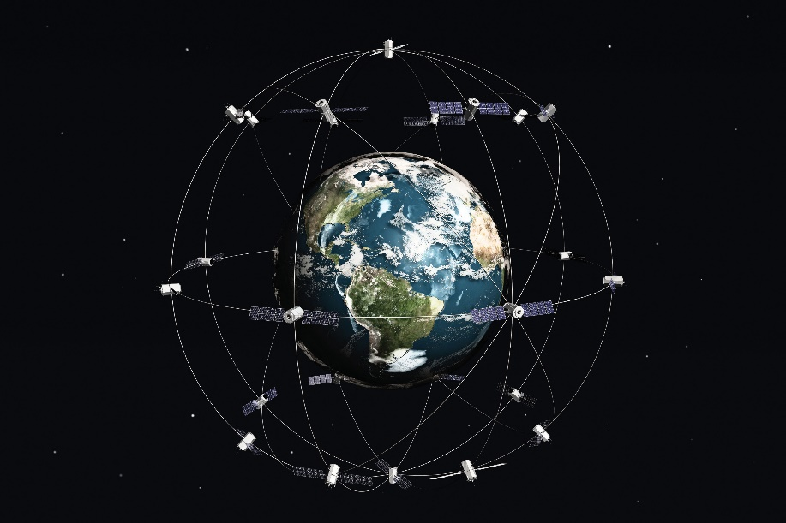
Why Geocache?
Any Content
Interactive
Motivating
Skill Development
Authentic Learning
Physical Activity
Fun!
Notes:
Geocaching lets students use current billion-dollar technology that is also used by the military, agriculture, transportation (rail, air, sea), first responders (police, fire, rescue), and communication industries. Geocaching can be used to assess current knowledge, present new information, and review – in ANY CONTENT AREA. The possibilities include (but are not limited to): learning about coordinates, leadership if used in groups, critical thinking and information analysis skills, and use for either formative or summative assessments.

Slide 5

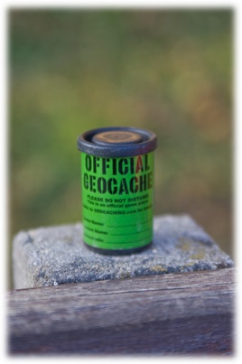
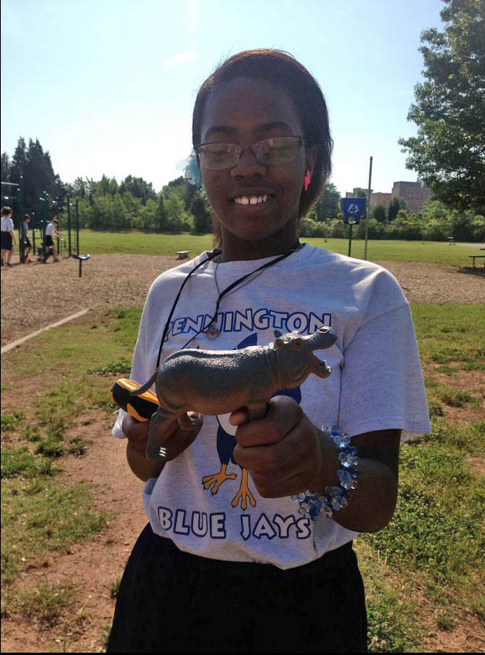
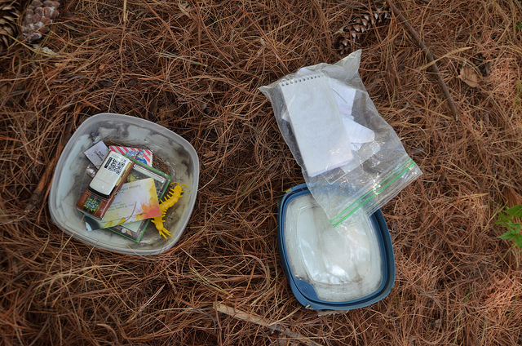
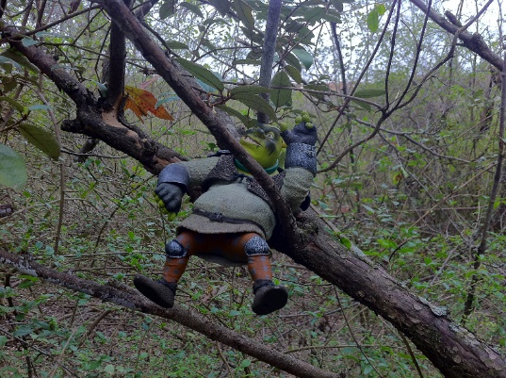
What is a Cache?
Any form (or size) of a waterproof container that folks with a gps device can locate using coordinates.
No drugs, alcohol, foodor weapons should ever be left in a cache.
Notes:
In off-campus geocaching, tradable trinkets are left inside the container along with a log book. ON campus caches can contain items as well but in most cases students leave the items in the container when they are done with the assignment accompanying that geocache. On campus containers can also contain questions – for which student enters an answer on a worksheet, answers/vocabulary– for which a student may have to figure out the corresponding question – kind of crossing geocaching with Jeopardy….etc.

Slide 6
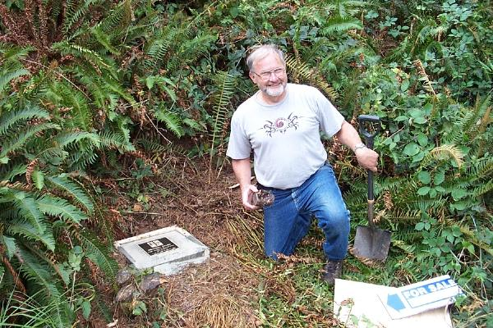
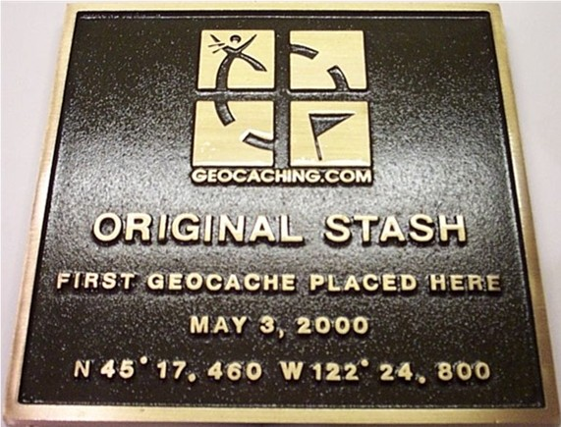
Founder of the First Geocache
Dave Ulmer
Image from: www.groundspeak.com
Dave with original stash tribute plaque
http://youtu.be/LMHZcgM11GU
video clip of first geocache, or click on picture to watch
(Need DivX codex to watch video)
Notes:
First cache officially hidden that generated the ‘craze’ was by Dave Ulmer on May 3, 2000.

Slide 7
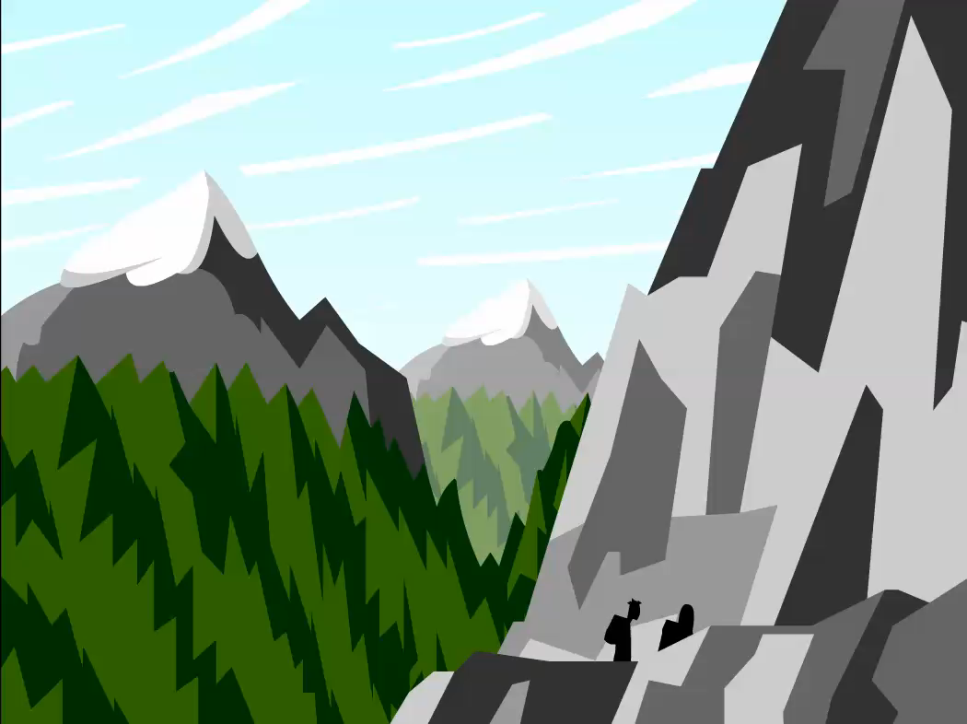
How Does GPS Work for Geocaching?
Video courtesy of BrainPop
Notes:
Click on Picture to see how GPS works. There are more than 26 satellites in orbit around the Earth, all used by GPS.

Slide 8
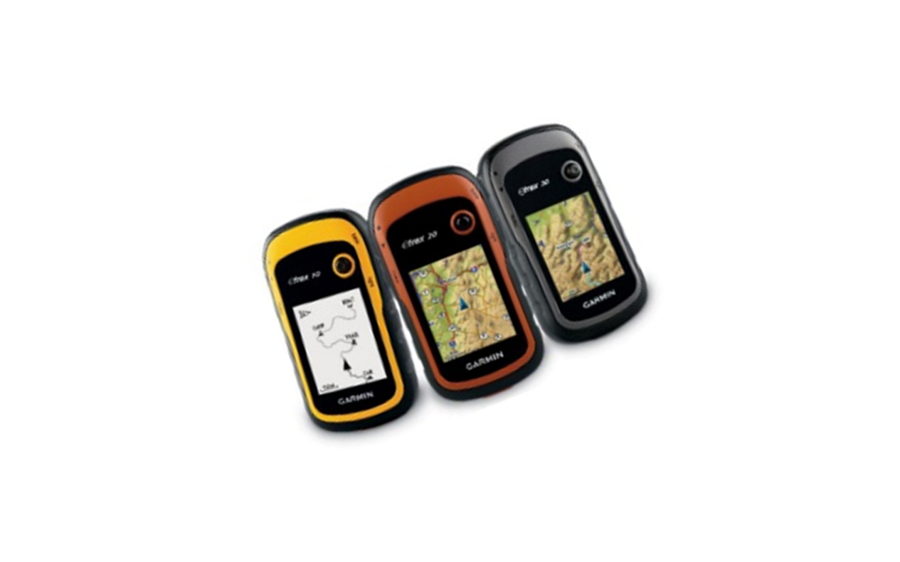
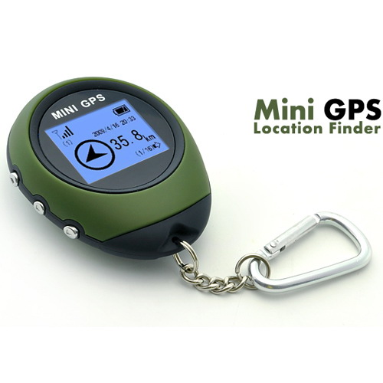
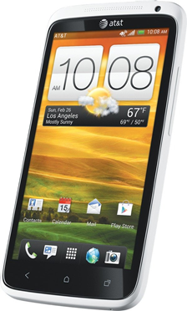
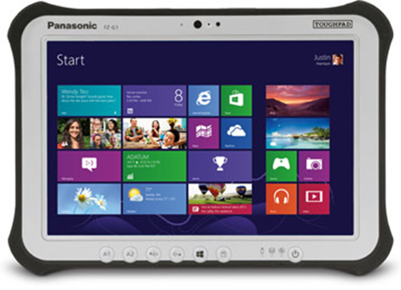
What exactly is a GPS Receiver?
Electronic device determining approximate location on the planet. Some units have extra features like maps, built-in electronic compasses, etc…
Extremely accurate, thanks to their parallel multi-channel design.
Average Cost: $100
Smart Phone or 4G tablet!
$34.00 for this mini

Slide 9


When Should You Use Geocaching?
Daytime
utside
Curriculum
Field Trips
Notes:
While you CAN geocache at night, it is not recommended. Caches are much harder to see and more difficult caches can be downright dangerous to find.
GPS receivers only work outdoors so you will want to watch the weather. If your devices are water resistant, you can still geocache in rain, snow, sleet, hail, and high winds.. But some are not recommended…
Geocache for ALL CURRICULUM CONTENT. If you allow BYOD at your school, you can integrate QR codes in your cache lessons!
Plan ahead for field trips and see what caches might be available to you while on the trip. You can also use your GPS to mark landmark locations and figure distance, etc. when you are back from your trip or use those landmarks with Google Earth/Tour Builder with Google to revisit/write about what you saw and how it relates to what you are currently learning in class. Track your route on the bus, on the trip, and back. Calculate the distance you traveled to the foot!

Slide 10
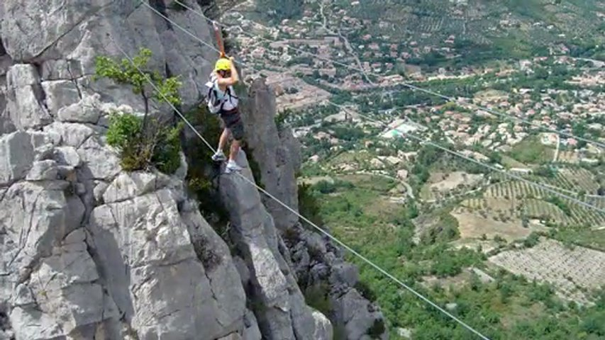
Where Should I Hide a Cache?
Be wary of seasonal (poison ivy) growth
Permission (parkland, schools, federal parks)
Can you maintain the cache?
Not close to water (flooding)
Beware of personal safety
(yours and geocachers)
Notes:
When hiding caches in fall, winter, or early Spring, check back to be sure there no poison ivy where your cache is hidden and be sure any cache you hide is close enough that you can reach it easily should it need maintenance.
If you want to hide caches on school property that you will leave out and register online, you need to get permission to do so and BE VERY CLEAR about times when cachers should NOT be on school property when you post your cache.
Personal safety is a must – do not place caches in or near bee hives, water, cliffs or ledges, or otherwise dangerous areas.

Slide 11
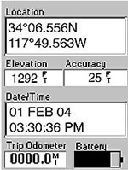
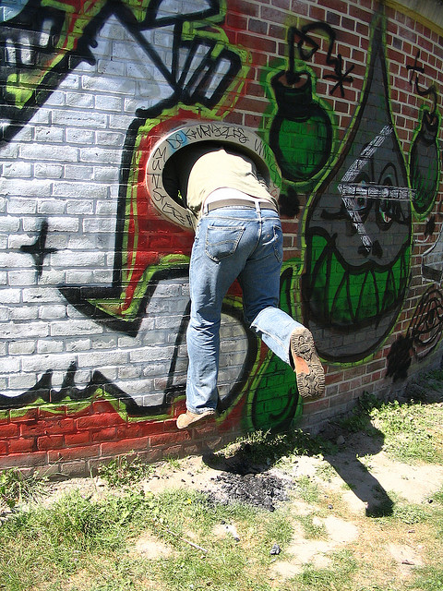
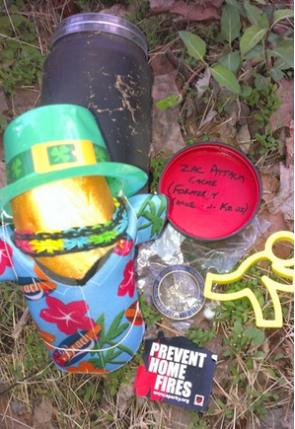
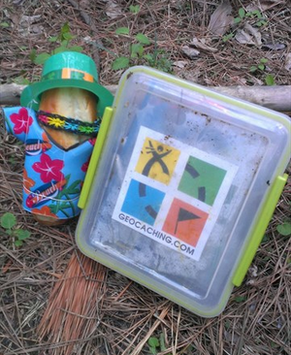
How do I find a cache?
Join a geocaching web site.
Print out or download the coordinates for a cache
Use your GPS receiver
to locate the site.
Keep in mind that
distances can be deceiving.
Notes:
You can join several free geocaching clubs to find caches in your area. We joined Geocaching.com. Sometimes walls and other items may be in the way that you must go around. Other times, the cache is on TOP of a building, in the air above you, or in an otherwise interesting position. Some geocache hiders are industriously creative in where they stash their cache.

Slide 12

Geocache Jargon
CITO-Cache In Trash Out
Datum-A datum is something used as a basis for calculating and measuring. In the case of GPS, datums are different calculations for determining longitude and latitude for a given location.
Geomuggle-A non-geocacher. Based on "Muggle" from the Harry Potter series, the term is used after a non geocacher looks puzzled at a geocacher making circles with their GPS receiver, or when a non-geocacher accidentally finds a cache. Geomuggles are mostly harmless.
Hitchhiker- Item placed in a cache with instructions to be taken to other caches.
Notes:
When out geocaching, take a bag with you and pick up trash along the way!

Slide 13
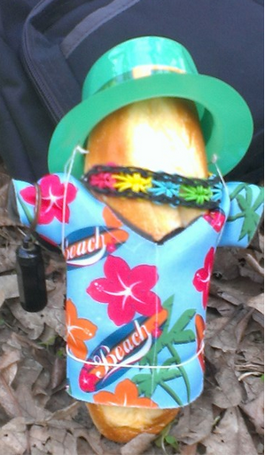

Jargon Continued…
Spoiler – duh.. Left online by cache finder…
TFTC - Thanks For The Cache
TNLN - Took Nothing. Left Nothing
Travel Bug/Trackable – hitchhiker, meant to travel
Waypoint - Coordinates representing points on the surface of the Earth (that point the way!)

Slide 14
Geocaching for Instruction
Hide caches on school campus marking their location (waypoint) with GPS.
Load coordinates to other devices (EasyGPS) or have students enter the coordinates instead.
Give students specific caches to find using GPS units.
Have last class pick up all cache finds.
Notes:
EasyGPS is a free downloadable program used to capture/upload all coordinates ‘marked’ by a single GPS device. The software is then used to download all coordinates to all other devices so they are all the same (requires USB cable to connect devices and can take some time to do depending on the number of devices you use.)

Slide 15
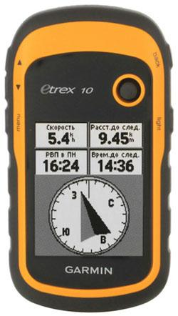
Menu Navigation
Back
Joystick
Menu
On/Off and
Backlight

Slide 16
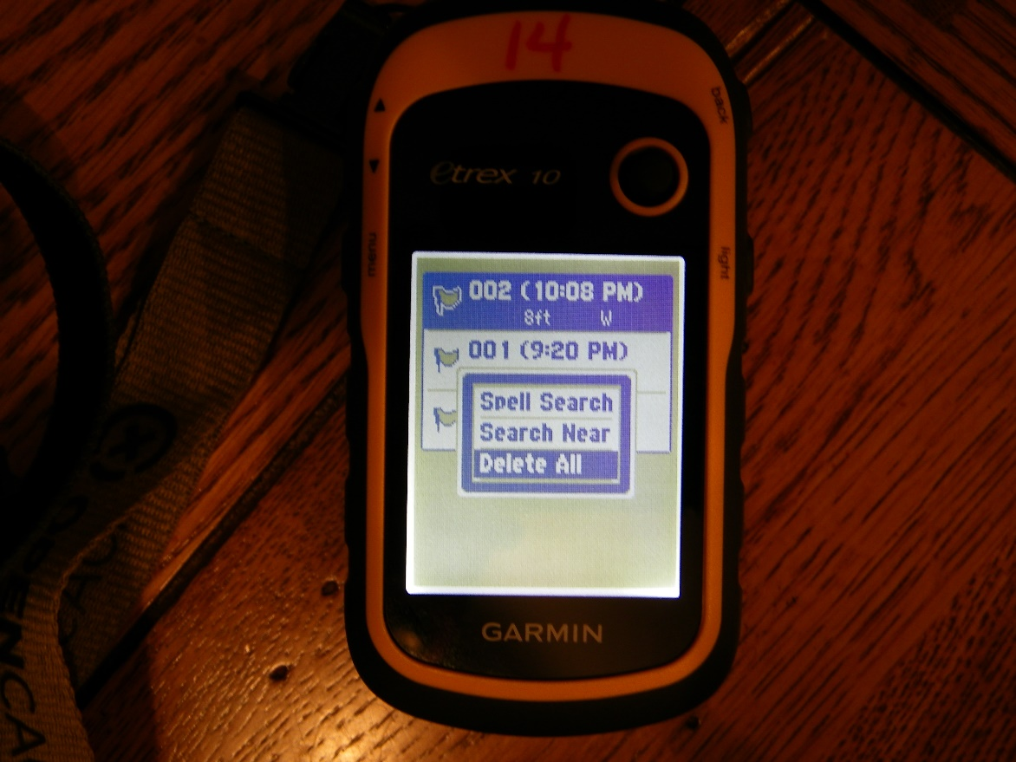
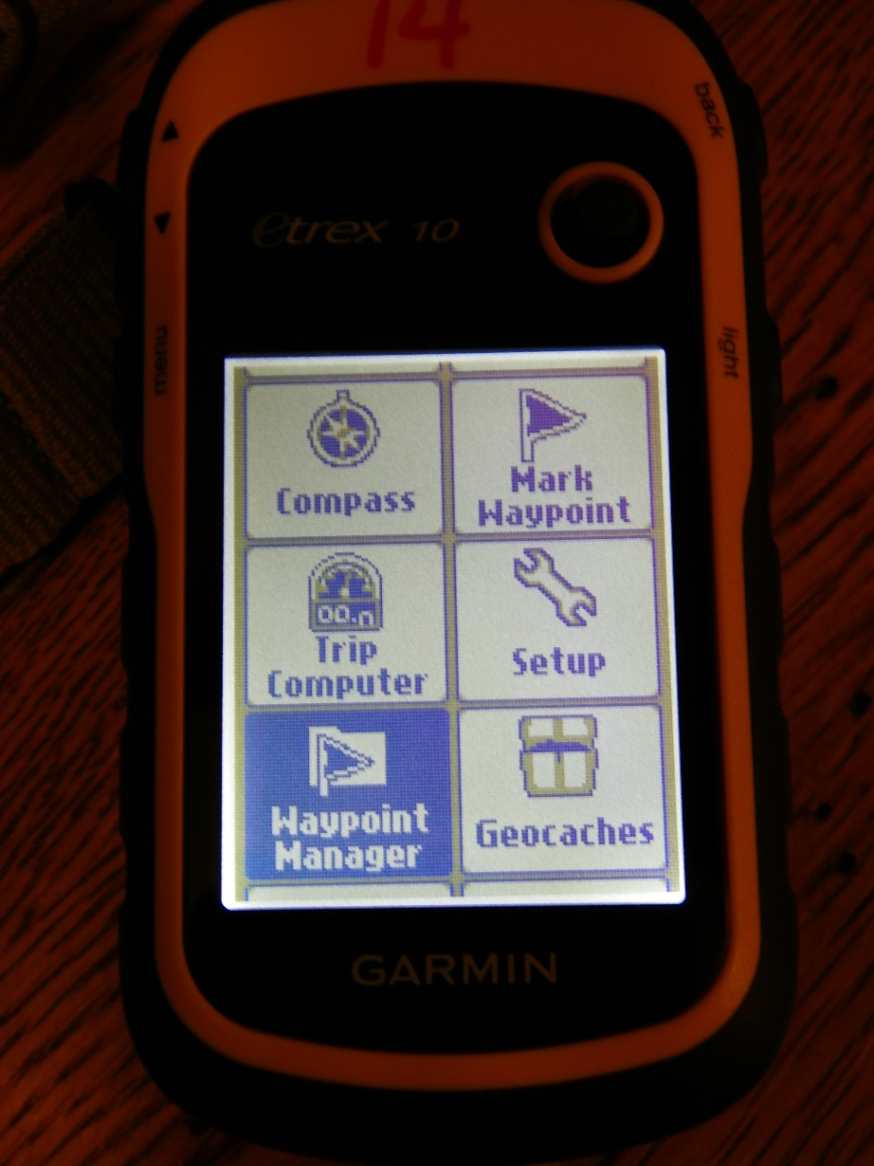
Mark a Waypoint (cache)
Before collecting new waypoints,delete ALL current waypoints on the GPS.
Using joystick, highlight WAYPOINT MANAGER. Press joystick IN to select.
Press MENU BUTTON on left side of GPS and select DELETE ALL.
Notes:
The waypoint is the cache location on the earth written in longitude and latitude coordinates. Your GPS device will calculate the waypoint for you when you MARK THE WAYPOINT.

Slide 17
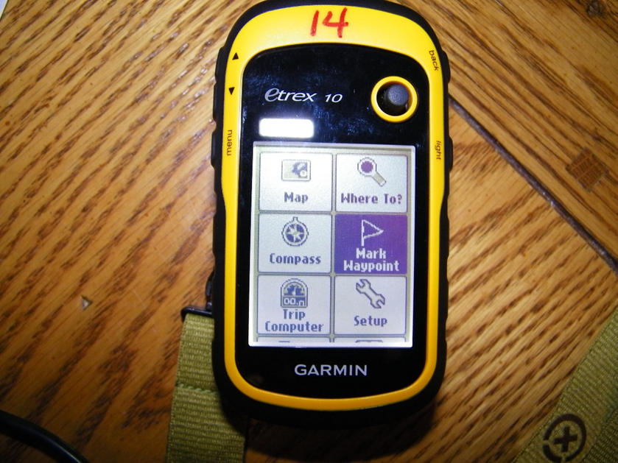
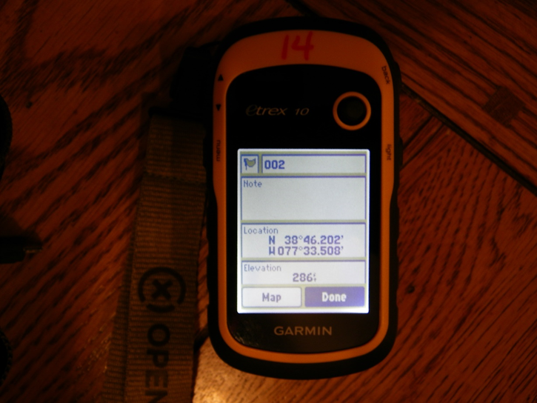
Waypoints and Cache Boxes
Place your FIRST cache box in it’s hiding location.
Hold the GPS device over the hiding spot or as near as possible.
Navigate to MARK WAYPOINT on the GPS and press the joystick IN to select.
Make sure the FIRST waypoint number is 001. Highlight DONE at the bottom and press the joystick IN to select.
Repeat all steps on this slide for each cache – making sure to click DONE each time so number for cache box = waypoint number.

Slide 18
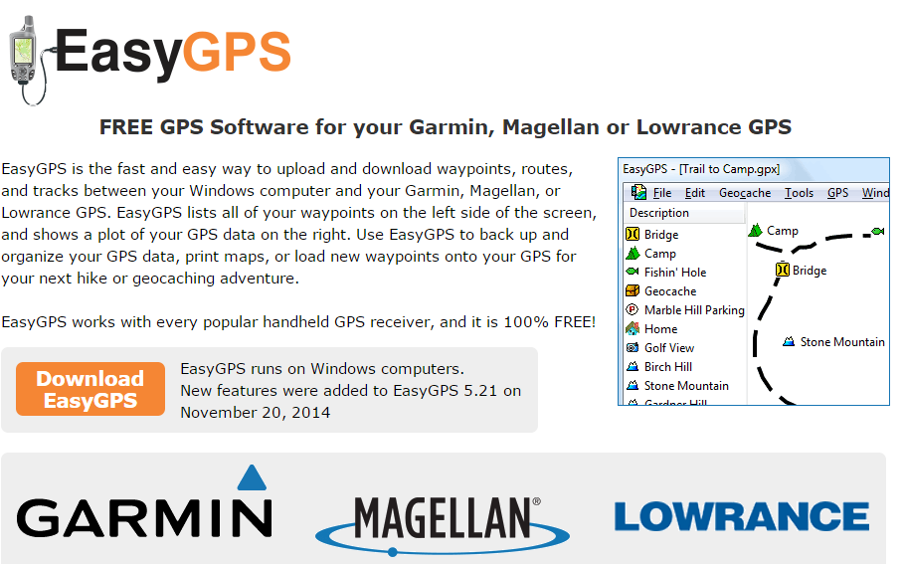
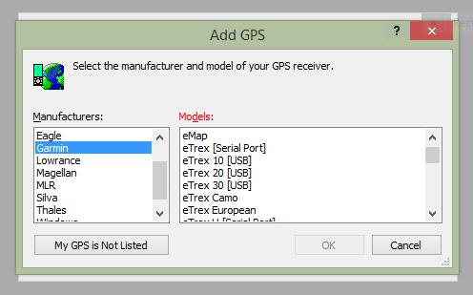
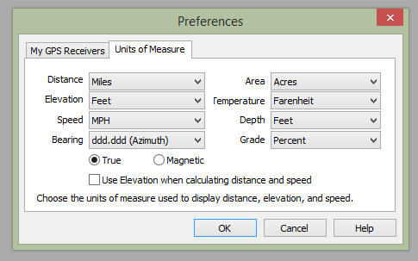
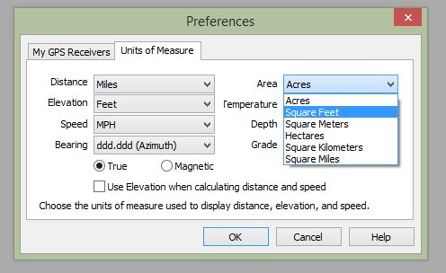
EasyGPS
Downloading Waypoints to Multiple Devices
Download EasyGPS from EasyGPS.com (free)
FIRST TIME USE:
Select GPS device
Setup units of measure
Distance, Area, etc.

Slide 19
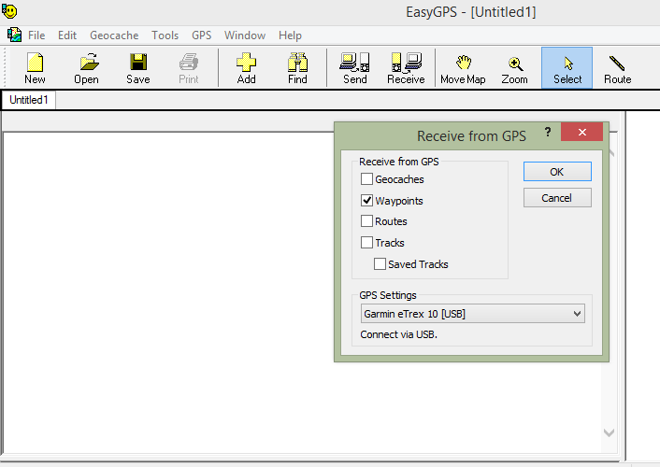
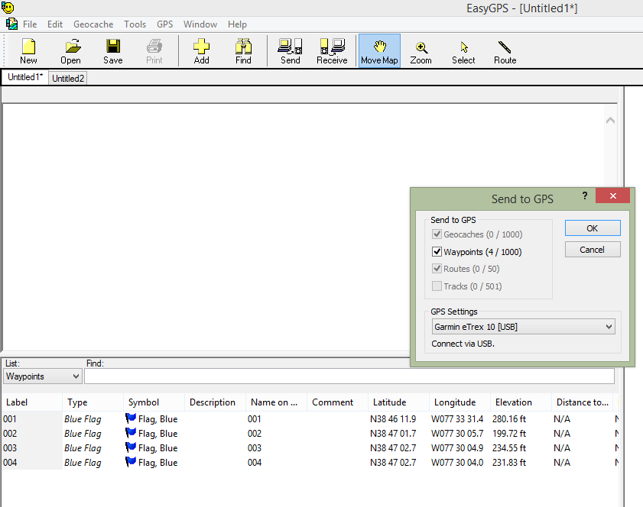
Loading Coordinates/Waypoints
Connect the GPS you used to mark your waypoints to a computer via the USB cable.
In EasyGPS, select RECEIVE.
Remove this GPS, connect another.
Select SEND.
Notes:
The receiving and sending of waypoints is extremely fast. You can get 30 devices loaded in mere minutes. After the GPS receives the waypoints list, you are ready!

Slide 20

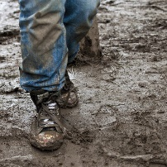
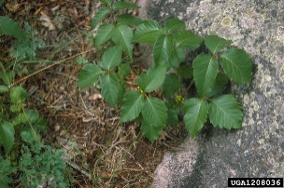

Best Practices - On-Campus Tips!
Students can work alone but pairs/groups are better
Rotate who handles the device so all can lead
Beware of
Have the last class return all caches they find (so you don’t have to collect them!)
Notes:
Students working together promotes collaborative teamwork, not only in finding the cache, but in solving the cache contents. Rotating the device for each cache gives all students a turn to lead the group. One locates the cache, the other gets to open it, etc.

Slide 21

Best Practices - Off-Campus Tips
Make sure you are with a buddy,
never go alone
Some of the areas might be muddy, hilly, etc. Dress appropriately.
Bring water or food if you head to a remote location.
Always tell someone where you are!
Bring extra batteries for your GPS receiver.
Bring topo maps to help pinpoint the area.
Notes:
These tips are for geocaching of

Slide 22
Etiquette – When you Find a Cache
CITO & TNLN
Wait for muggles to leave area
Bring a pen (sign the log)
Return cache to same spot (unless hitchhiker)
Move trackables/hitchhikers along
Leave No Trace
Register find online ‘found’ or ‘DNF’ and notify CO if maintenance is needed.
Notes:
Cache In Trash Out – Bring a trash bag and pick up any trash you find along the way
Take Nothing Leave Nothing – If you don’t like the trinkets or have nothing to trade, don’t take anything from the cache box and don’t leave anything unless you want to (like somebody else’s trackable!)

Slide 23



TOP 5 APPS - Android
CacheSense $5.00
The legendary Blackberry Geocaching app (the first app to be licensed to use the Geocaching API) now on Android. This app is available for a FREE 30 day trial before you buy!
C:geo - Free
One of the best and free, geocaching app for Android. This one has been around for quite a while. c:geo is an open source, full-featured, always ready-to-go client for geocaching.com
Geocaching - $9.99
The official geocaching app for Geocaching.com from Groundspeak. The most noticeable feature of this app is that it is the most expensive paid geocaching app on the market. Overall, it is a good app for the beginner, you want to be connected to the official Mother of Geocaching, then this app is for you.

Slide 24


Neongeo- $4.26
This app includes a nice social function, ‘Follow Me’, which allows you to shares your location and allows you to see others on the map as well. You also have the option to send others using Follow Me a message, which comes in handy when you are with a group of folks.
This app is easy to use and also provide a 30 day free trial.
A:DRAKE - Free
This app is pretty new to the market and claims to be able to work with huge cache databases, 30,000+ according to the listing in the G.P.S.

Slide 25
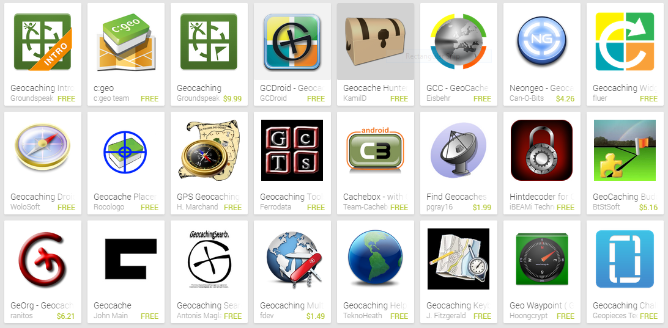
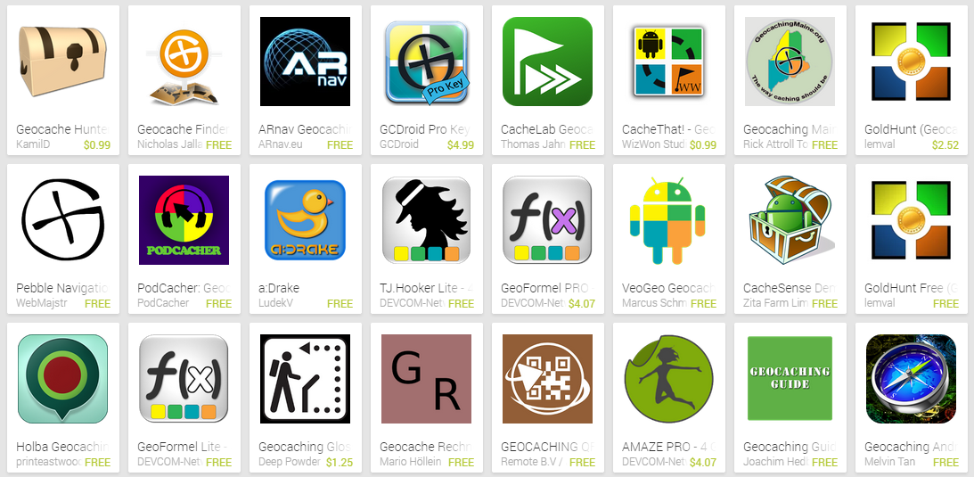
Apps - Android
Notes:
There is a plethora of geocaching apps – here’s a short list….
MOTHER OF ALL GEOCACHING APPS: Geocaching.com - $9.99 - The official app for Geocaching.com /Groundspeak. Most expensive. Overall good app for the beginner. Found on Google Play Store.

Slide 26
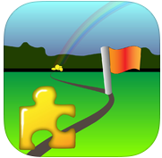
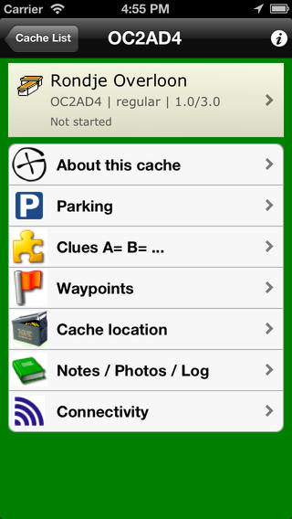
TOP 5 APPS - Apple
Geocaching Buddy - $7.99
Integrated navigating from waypoint to waypoint. Calculated new waypoints can also be shown on the Map (when internet is available).
Main features
===============
- Add caches from geocaching.com, opencaching.de, .pl, .us, or .org.uk
- Prepare a multi-cache at home on the device or using the web interface
- All images embedded in the local description are preloaded: paperless caching!
- Navigate to the parking location
- Make log notes while caching
- Post a log and optional photo
- Find your way back to the parking
- Manage the list of caches
- Photo album for each individual geocache + in-app camera + photo viewer
- In-app compass in the Navigate View
- In-app rotating waypoint overview map

Slide 27


Geocaching Intro (Free)
GroundSpeak is the company that runs the Geocaching.com website – The Mothership! The app is a way to get you hooked on geocaching by letting you find three geocaches near your current location, provide you with the requisite coordinates, hints, and description, and help you navigate to the cache. A bonus is that the app alerts you when you're getting close to the cache location by vibrating and making a sound. Great for newbies!
Looking4Cache Lite Free
Key functions:
- Get Caches from the Geocaching Live API or from GPX Files
- Manage caches in lists and find them with a lot of sort and filter options.
- Directly log a cache or send field notes. Also for multiple users. Owner logs are possible.
- Search and log trackables.
- GCVote integration.
- Maps: OpenStreetMap, OpenCycleMap, MapQuest, Bing and more.
- Offline caching supported (offline maps are only available in the pro version).
- Save power and cache longer. The GPS changes the accuracy automatically based on the distance to the cache.

Slide 28
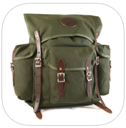

GeoCaches - Free
Easy to use app, just open the app on your iPhone, and in just seconds, it determines your GPS coordinates and a list opens with nearby caches. Way too easy!
Cache Me - $6.99
Application features:
- list caches nearby your location. Sorted by distances.
- list all caches in the map
- find your nearby caches on the map
- support "My Favorite" cache items
- view cache difficulty, terrain, size, and awesomeness.
- view cache description, photos and hint.
- view your location and cache position on map.
- compass view with the cache distance and direction
- support street/satellite/hybrid map, and open street map
- support log this cache after found it

Slide 29
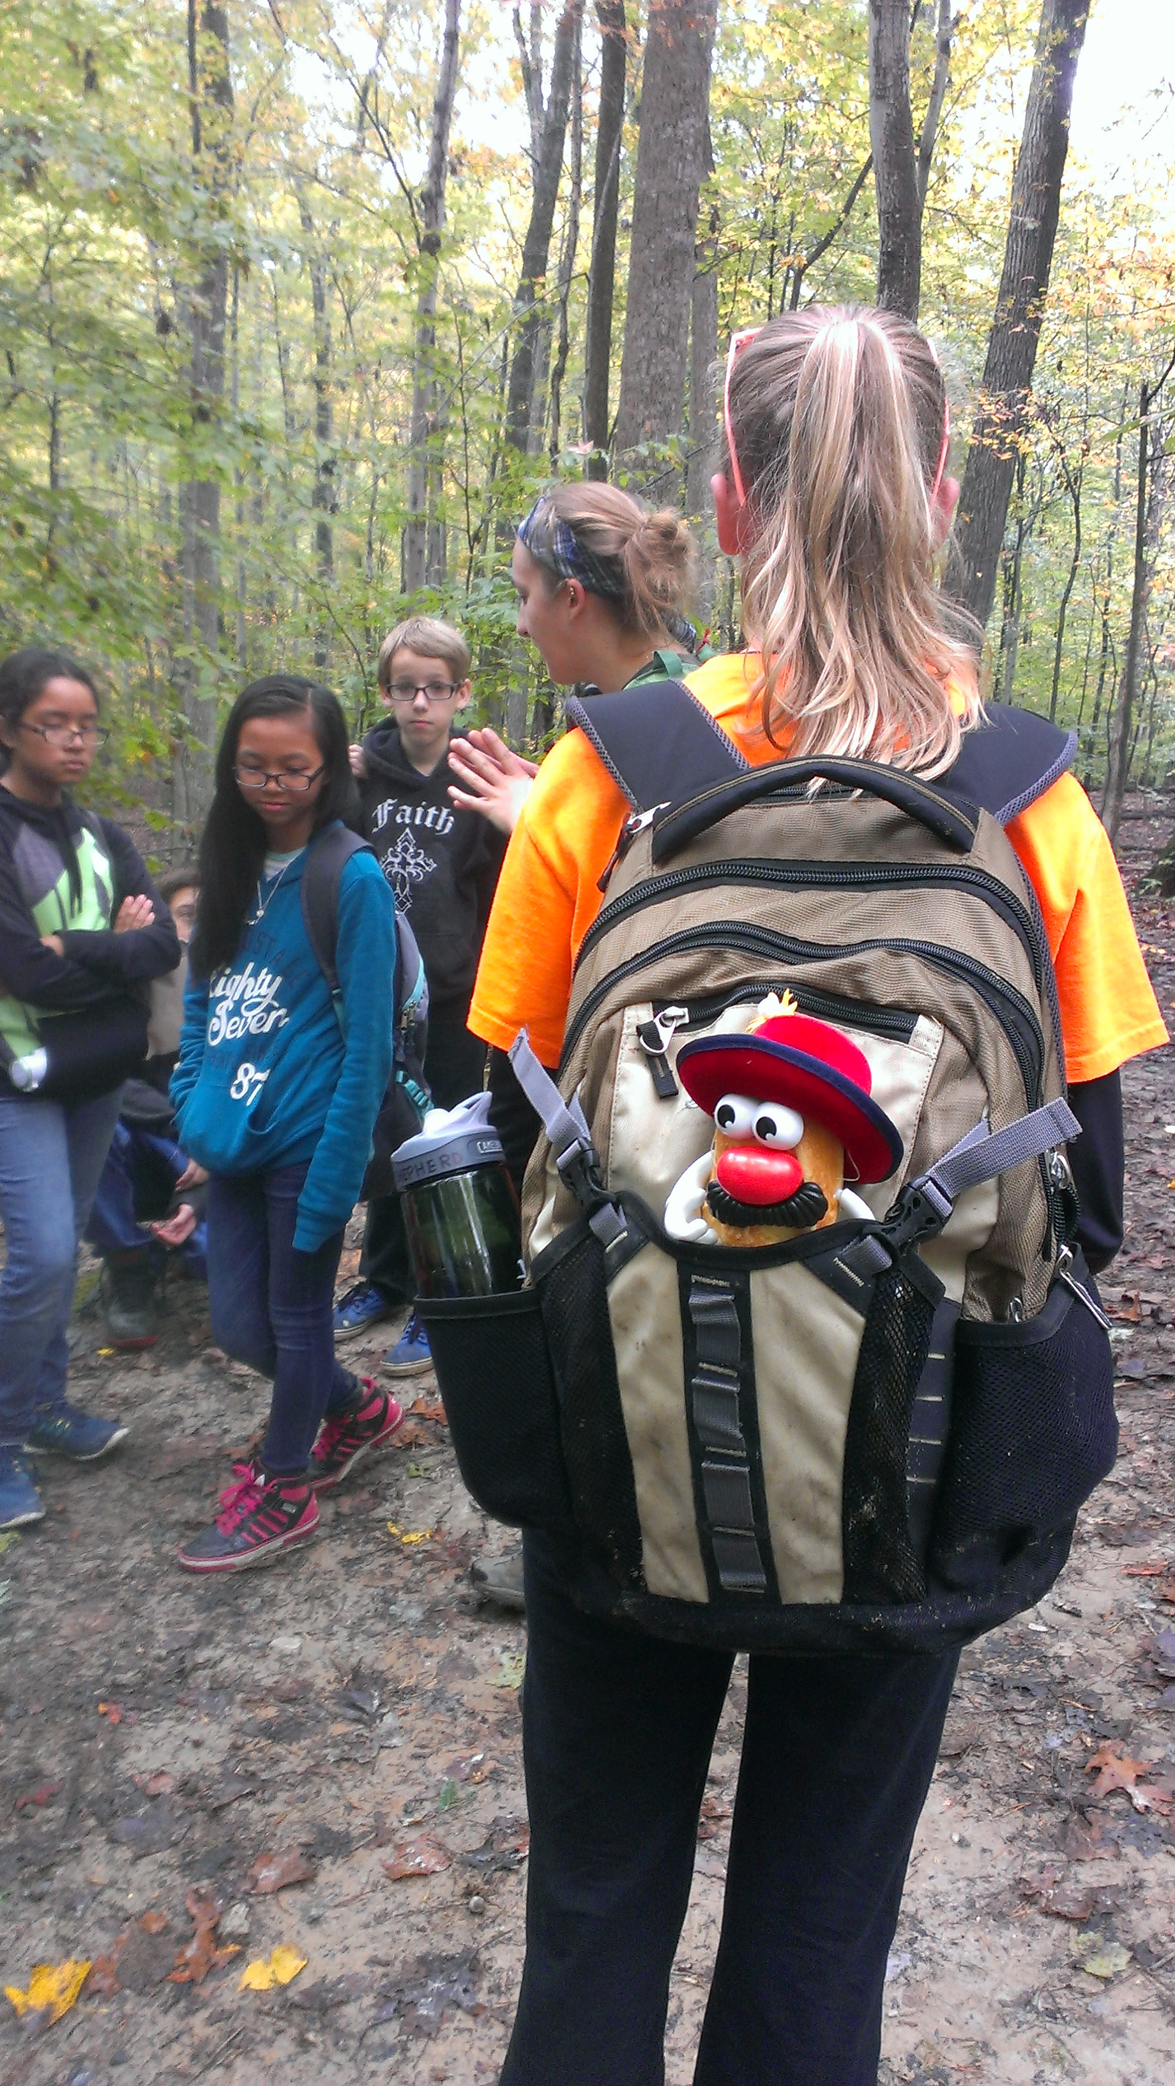
Using Geocaching.com
Register for an account
Register your campus cache(s)
Use Boulter.com to measure distances
between caches
Register your trackable
Track your trackable
Search/download caches to find
Register your finds/DNFs
Register retrieved trackables

Slide 30
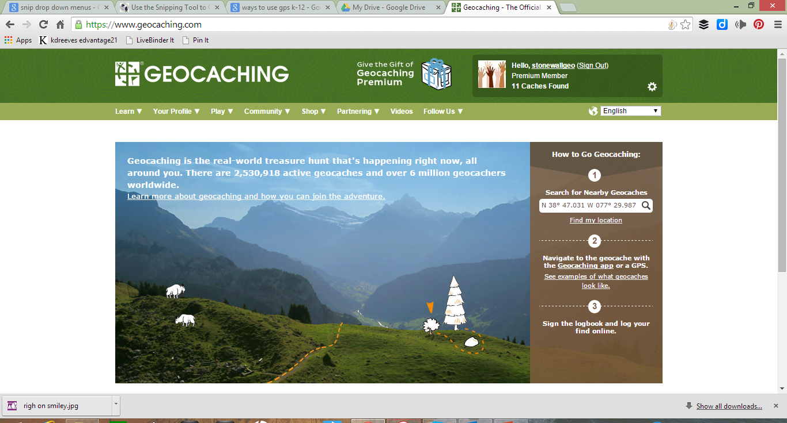
Geocaching.com
Notes:
Go to geocaching.com and register for a free account! (Only the device apps cost $$)

Slide 31
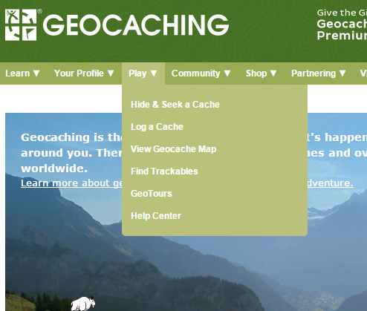
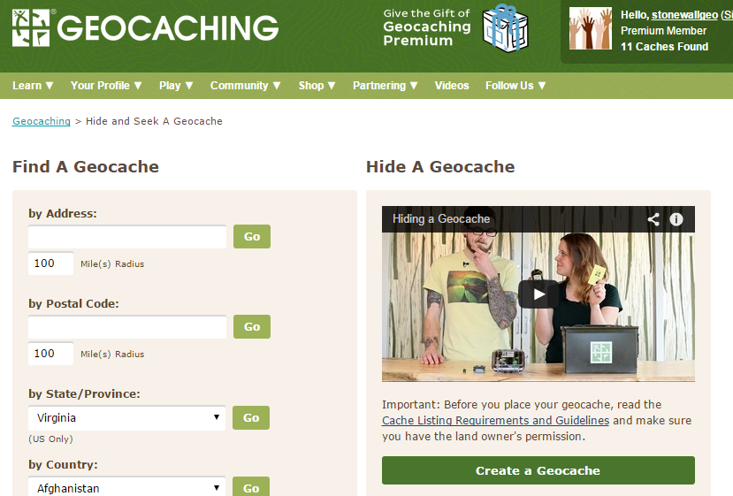
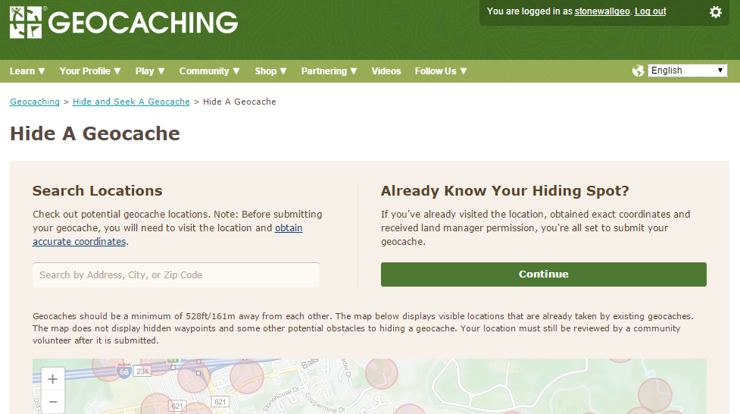
Hide and Register a Cache
Hide your cache and mark the waypoint. Walk away about 100 feet and try to locate the waypoint with your GPS. Do this several times for accuracy.
Open Geocaching.com and log in. Click down-arrow on PLAY and select Hide & Seek a Cache.
From this page, you can either SEEK a cache (on left) or HIDE a cache (on right). Choose CREATE A GEOCACHE on the right side.
Since you have a waypoint, choose
CONTINUE (green bar).

Slide 32
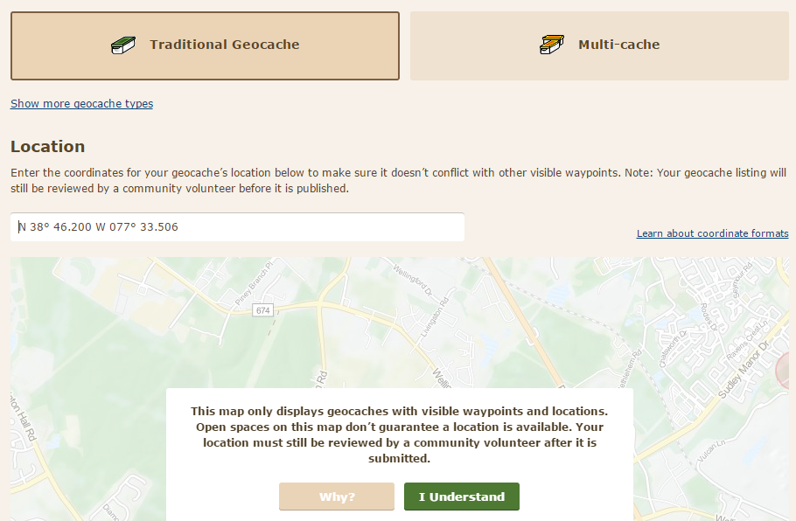
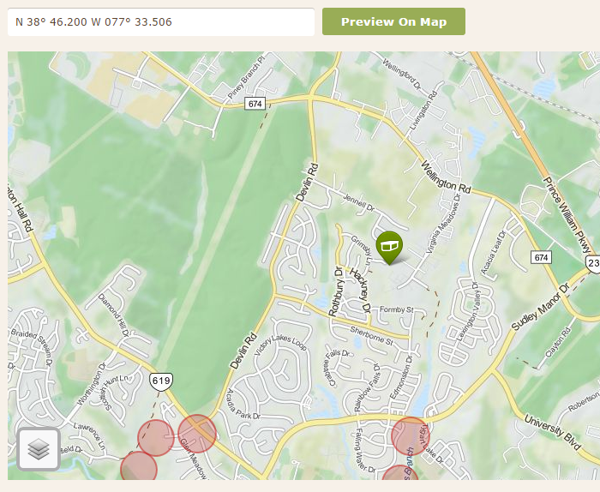
Registering a Cache
Click on TRADITIONAL CACHE and enter your exact coordinates as displayed on your GPS unit in the field. Double check!
Click I UNDERSTAND and you will see a map that shows the exact location you have entered. Make sure it matches your hiding spot.
Click CONTINUE. If you want to add additional waypoints you can – such as where geocachers can park, reference points, etc., you can add them on the next page.
Click CONTINUE and give all the details for your cache.
Notes:
When giving details for your caches be sure to leave times when you do NOT want people roaming your school campus and make it clear the authorities will be called if they do not comply. This will make it easier for you to get your cache approved by the reviewer (who is a local volunteer). If you are placing more than 1 cache, they must be 568 feet apart. Use Boulter.com to check your distances! (If your gps reads you are more than .1 mile from your nearest waypoint/cache, you are fine. 528 feet is just under .1 mile.

Slide 33
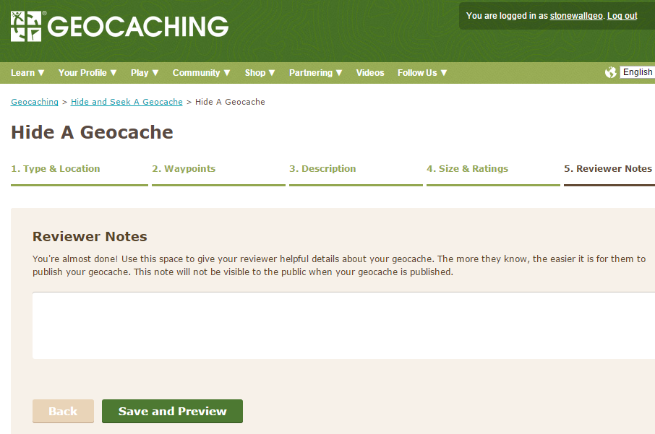
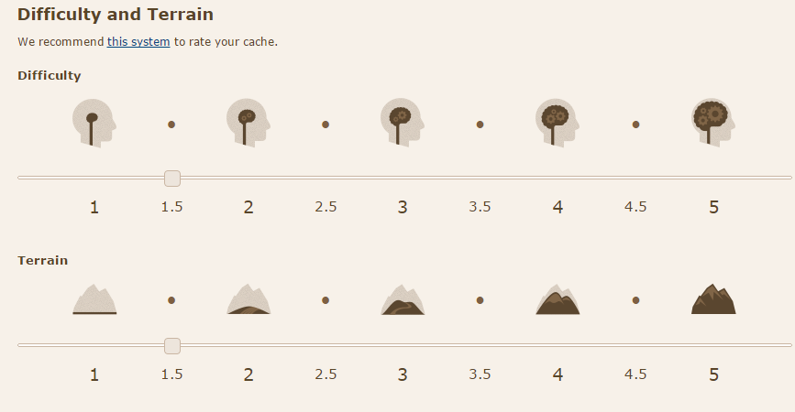
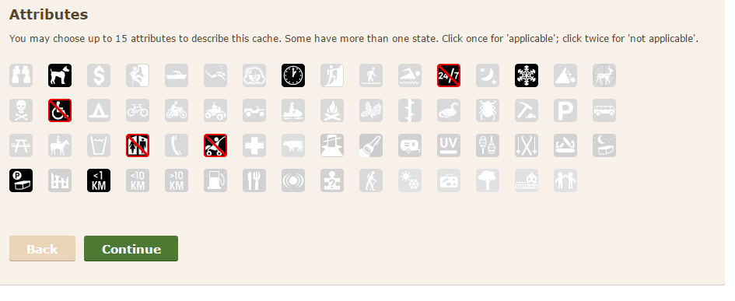

More Cache Details:
Notes:
Choose the size of your cache, the difficulty and terrain ratings ( you can click on the link ‘this system’ to get recommendations for rating these), set the attributes (double clicking indicates NO). Click CONTINUE.
Leave a note for the reviewer. If you are placing caches on school property, make sure they know you have permission from administration.

Slide 34

Geocaching Today at VSTE
Using your cell phone? Download a free geocaching app.
No device? Please use one of the etrex Legend devices we have with us today.

Slide 35
Finding a Waypoint with etrex 10
Power on the GPS - hold power button (light button) or 3 seconds, give
GPS about 2 minutes to acquire satellites before trying to find a cache.
2. Using the joystick, navigate to WHERE TO, press joystick IN to select
3. Select WAYPOINTS
4. Use joystick to hightlight your assigned cache box to start your adventure
5. Press joystick IN to select GO at bottom.
6. Press back button (top right).
7. Navigate to and select COMPASS
Begin walking and follow the narrow end of the compass, watch for your
distance from the waypoint in top right corner.
9. When you are within 15 - 20 feet, begin looking for your cache container.
10. Press BACK button, navigate and select WAYPOINTS
11. Navigate to STOP NAVIGATION
12. Return to step 2 and repeat for all new waypoints.

Slide 36





Activate a Trackable (Travel Bug)
Notes:
On geocaching.com, select PLAY, then FIND TRACKABLES.
On the next screen, enter your activation code (found on back of trackable) in the bottom field and click ACTIVATE.

Slide 37




Trackable Details
Notes:
Enter the Mission (what do you want to happen with this trackable?), Details (what does your travel bug look like, is it collectible?, etc.) You may upload an image as well – maybe of your whole class with the trackable, a pic of your school, etc.). To save, click EDIT TRACKABLE DETAILS on the bottom of the screen.
Set the Release location and click COMPLETE ACTIVATION.
From the next screen, click on VISIT YOUR TRACKABLE’S HOME PAGE to review the listing.

Slide 38





Trackable’s Homepage and Making the Drop
Notes:
Now to go your cache box listings by clicking on PLAY, and the word YOURS next to GEOCACHES from the menu bar. Select the geocache you want to drop your trackable in. On the geocache page, click the green box on the right side that says LOG YOUR VISIT. Choose WRITE A NOTE. At the bottom of the screen, click on ACTION for the travel bug in your inventory, change this to DROPPED OFF and SUBMIT YOUR ENRY.
I dropped this travel bug off in a geocache placed in front of our school last Spring.

Slide 39

After Activation – The Drop
Notes:
Informational page only.

Slide 40

Tracking the Trackables
Notes:
To get to YOUR trackables, click on YOUR PROFILE, then on the drop-down, click on the word YOURS, next to trackables. Notice, my STMS7 Travel Bug has traveled more than 16,000 miles since April of this year! Get more information by clicking on the Travel Bug’s NAME.

Slide 41

Geocaching
Clubs on the Net
www.geocaching.com
www.terrecaching.com
www.navicache.com

Slide 42



So what are you waiting for? Let’s go Geocaching!

Slide 43


Best Practices, Tools, Resources
Geocaching Blog http://www.geocaching.com/blog/2013/10/1-geocaching-app-trick-to-rule-them-all/
Geocaching 101: http://www.geocaching.com/guide/default.aspx
Website for Conference info Website to Lesson Plan

Slide 44
Deeper Learning Approaches
Take GPS on field trips
Teach basic map skills (coordinates)
5 Themes of Geography - Absolute Location, movement, resources, human environment, place
Use as an Evaluation Tool

Slide 45
Roadblocks
Weather - Rain, snow, cloud cover, solar flares ....
Expense - Where does one gather the financial resources to fund geocaching?
Location, location, location...
Staff Support
Time

Slide 46

Calculating Distance Between Caches
Boulter.com

Slide 47

VSTE Community of Practice
Learn to Use This Site

Slide 48
Door Prizes!!!
#1 – Cache Box
#2 – Travel Bug - Rudolf
#3 – Cache Box
#4 – Travel Bug - Elf
#5 – Travel Bug Dog Tags

Slide 49

Bo? Wanna
go Geocaching?

Slide 50
Credits
Information: www.geocaching.com
Explorist GPS Image: http://www.magellangps.com/products/
BrainPop

